Slide 1
Statistics and Reliability: Module 5
Capability
Notes:
Module Topics
Process capability studies
Process performance vs. specification
Process capability indices
Process performance indices
Short-term vs. long-term capability
Process capability for attributes data
Copyright (c) Deere & Company, as an unpublished work. This material is the property of Deere & Company. All use, disclosure, and/or reproduction not specifically authorized by Deere & Company is prohibited.

Slide 2
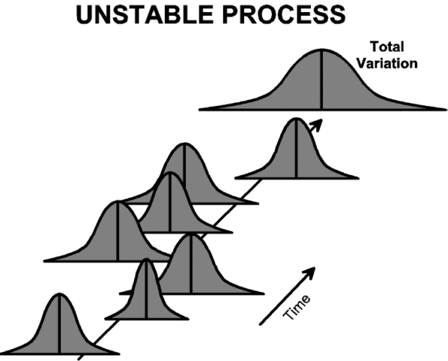
Notes:
A capability study is used to determine whether a process is stable and capable. It involves collecting samples over a period of time. The average and standard deviation of each time period is estimated and these estimates plotted in the form of a control chart. These control charts are used to determine if the process is stable. If it is, the data can be combined into a single histogram to determine its capability.
The figure above shows an unstable process. The process is constantly changing. The average shifts up and down. The variation increases and decreases. The total variation increases due to the shifting.

Slide 3
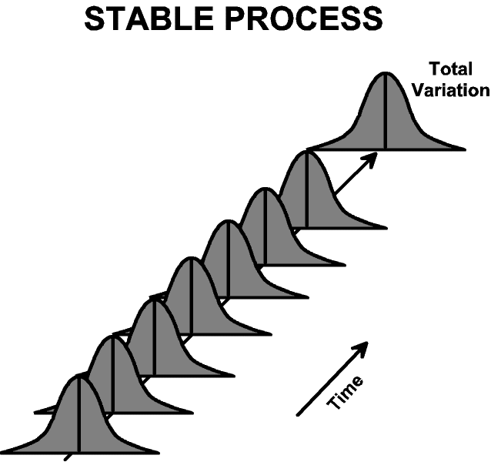
Notes:
Instead, stable processes are desired as shown below. Stable processes produce a consistent level of performance. The total variation is reduced. The process is more predictable.

Slide 4
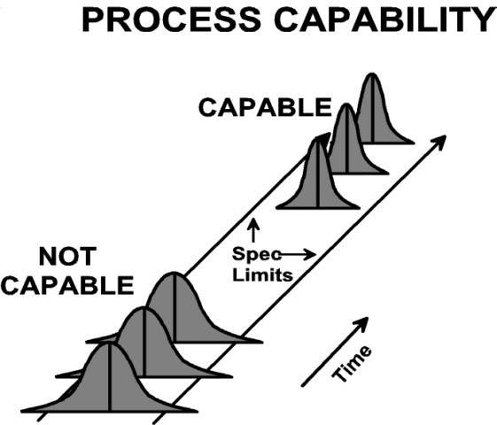
Notes:
However, stability is not the only thing required. Once a consistent performance has been achieved, the remaining variation must be made to safely fit within the specification limits. Such a process is said to be stable and capable. Such a process can be relied on to consistently produce good product.

Slide 5
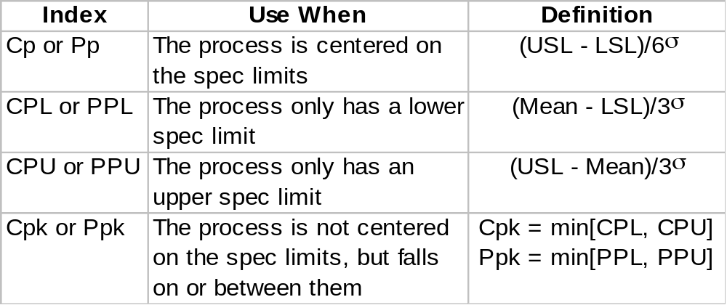
Traditional Process Indices
Notes:
Cp and Pp: Ratio of the tolerance (the width of the spec limits) to the actual spread (the process tolerance).
Cpk and Ppk: Ratio of the tolerance (the with of the spec limits) to the actual spread, taking into account the process mean relative to the midpoint between specifications.
Cp/Cpk differ from Pp/Ppk by the method of estimating σ.

Slide 6
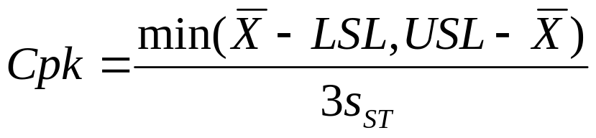
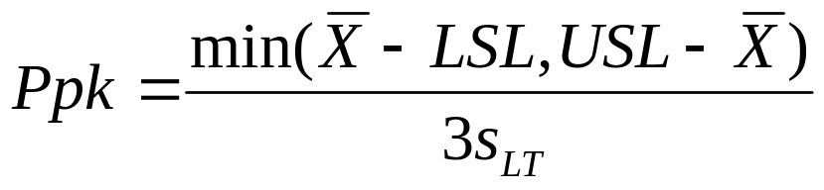
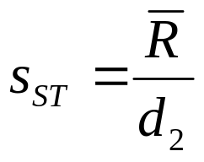
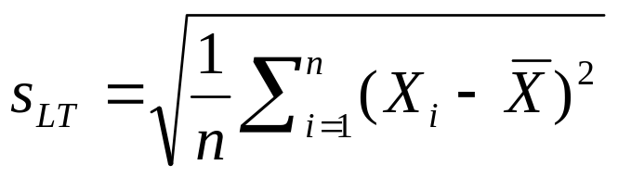
Short-term and Long-term Capability
Short-term Capability
Long-term Capability
(From control chart of a “small” amount of trial run data)
(From a “large” amount of production data)
Standard of Excellence: Cpk > 2.0
Standard of Excellence: Ppk > 1.5
Notes:
Process Capability
The 6σ range of a process’s inherent variation, for statistically stable processes only, where σ is usually estimated by R-bar/d₂
Use Cp, CPL, CPU or Cpk
Short-term capability, i.e. “best-case”
Process Performance
The 6σ range of a process’s total variation, where σ is usually estimated by the sample standard deviation
Use Pp, PPL, PPU or Ppk
Long-term performance, i.e. “actual”

Slide 7
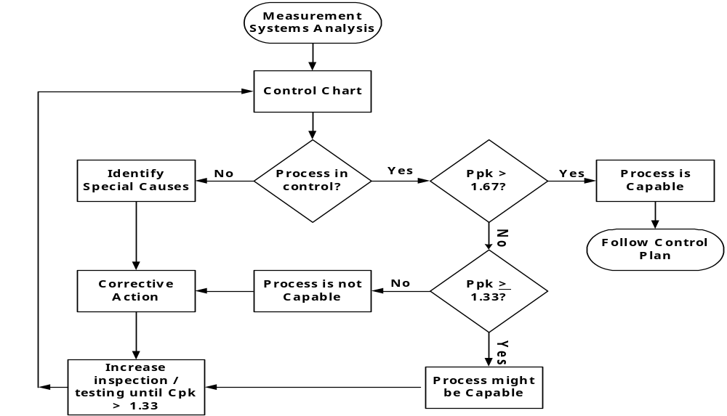
PPAP Capability Criteria
Notes:
Capability Study
What: Determining if the production process is likely to produce product that will meet the customer’s requirements.
Why: Being in-control is not enough; an in-control process can produce bad product; a capable process produces less bad products than a non-capable process with 100% inspection.
When: Need to determine whether a process, given its natural variation, is capable of meeting established specifications (see APQP & PPAP processes).
How:
Perform Measurement Systems Analysis
Determine whether process is in-control using a control chart
If process is in-control, determine whether process is capable using:
Ppk = min[(mean - LSL)/3σ, (USL - mean)/3σ]
σ = standard deviation of all data (long-term)
Cpk = min[(mean - LSL)/3σ, (USL - mean)/3σ]
σ = standard deviation from control chart (short-term)

Slide 8
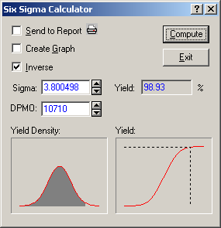
Notes:
Statistics > Probability Calculator > Six Sigma Calculator
Pages 191-192
DPU = 5/467 = 0.01071, so DPMO = 10710 (page 191)
Yield = 98.93 (page 191)
Sigma Level = 3.8 (page 192) – Note: Statistica included the 1.5 Sigma Shift, so this is a short-term capability metric

Slide 9
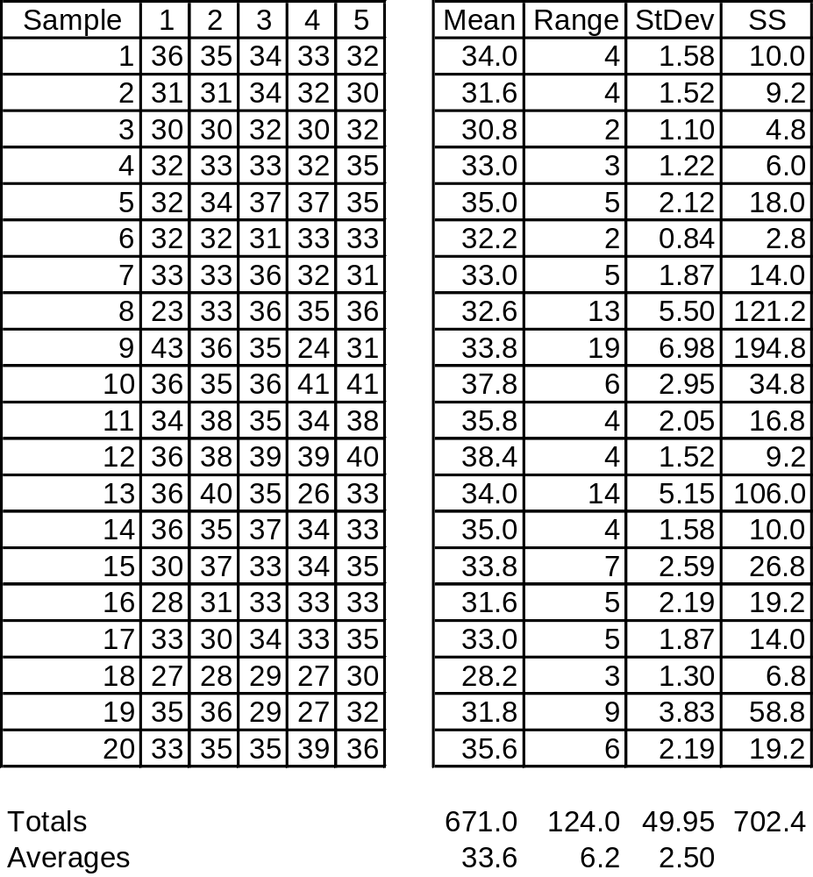
Table 11.1 Data and Calculation for Assessment of Process Capability Indices
Notes:
Example 11.11 Example 11.1: Process Capability/Performance Indices
Page 270: “For this process, specifications are 0.4037 + 0.0013 (i.e. 0.0424 to 0.4050). Tabular and calculated values will be in units of 0.0001 (i.e. the specification limits will be considered 24 to 50).”
Spec Limits = 37 + 13

Slide 10
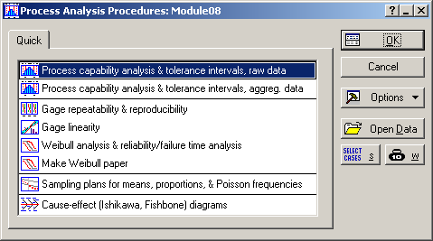
Notes:
Statistics > Industrial Statistics & Six Sigma > Process Analysis > Process capability analysis & tolerance intervals, raw data

Slide 11
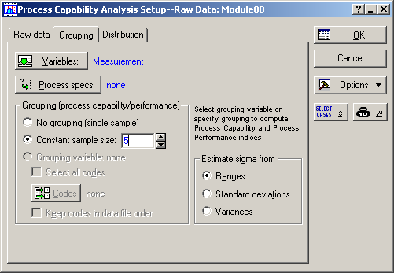
Notes:
Grouping tab
Variables = Measurement
Constant sample size = 5
Select “Process specs” button

Slide 12
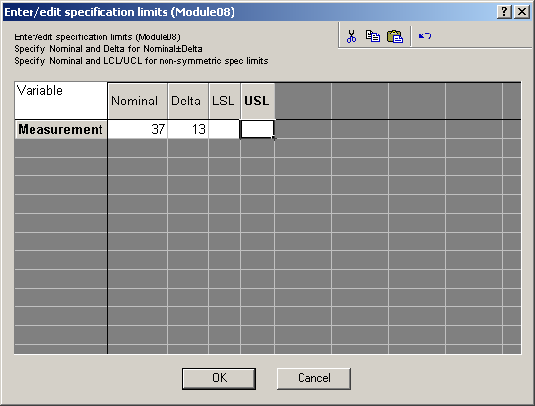
Notes:
Nominal = 37
Delta = 13
Note: use LSL or USL if there are one-sided specifications, and use both if there are asymmetric specifications.

Slide 13
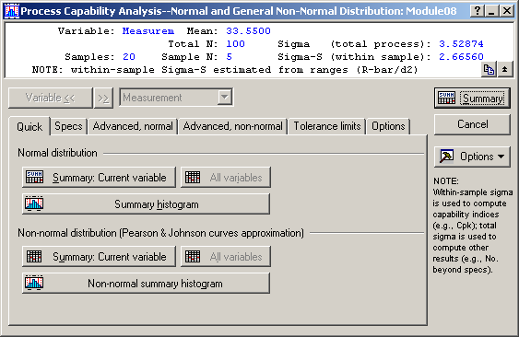
Notes:
Summary statistics are on top:
Mean = 33.55
Total N = 100
Samples = 20
Sample N = 5
Sigma (total process) = 3.52874 – sample standard deviation based on 100 samples (page 270)
Sigma-S (within sample) = 2.66560 – standard deviation based on average range (page 271)
Select the “Summary histogram” button.

Slide 14
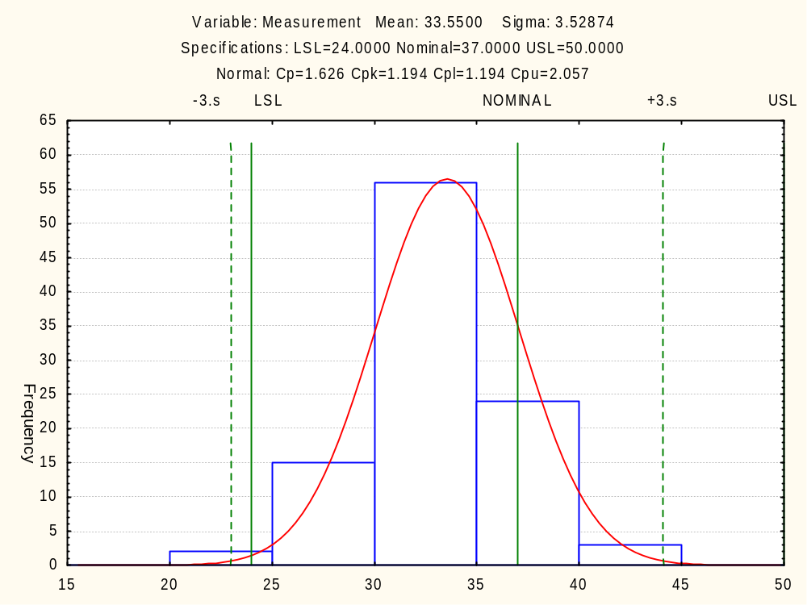
Notes:
Summary statistics are on top:
Mean = 33.55
Sigma (total process) = 3.52874 – sample standard deviation based on 100 samples (page 270)
Cp = 1.626
Cpk = 1.194
Cpl = 1.194
Cpu = 2.057
Return to the Quick tab and select the “Summary: Current variable” button.

Slide 15
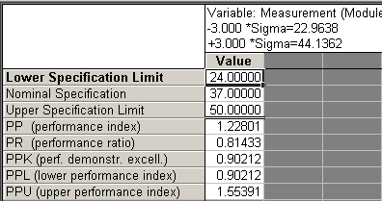
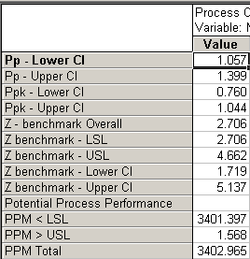
Method 1 (Long-Term View): Using Individual Data Points
Notes:
Sigma (total process) = 3.52874 – sample standard deviation based on 100 samples (page 270)
Compare to results on pages 271-272.
Pp = 1.228
Ppk = 0.902 (Ppl = 0.902, Ppu = 1.553)
Z LSL = 2.706
Z USL = 4.662
PPM LSL = 3041.4
PPM USL = 1.6
PPM Total = 3403.0

Slide 16
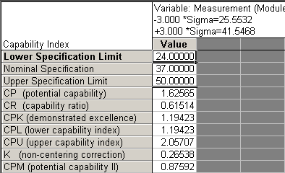
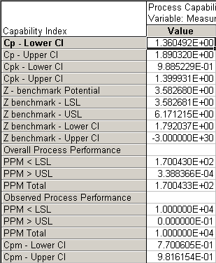
Method 2 (Short-term View): Using Average R
Notes:
Sigma-S (within sample) = 2.66560 – standard deviation based on average range (page 271)
Compare to results on pages 272-273.
Cp = 1.626
Cpk = 1.194 (Cpl = 1.194, Cpu = 2.057)
Z LSL = 3.583
Z USL = 6.171
PPM LSL = 170.0
PPM USL = 0.0
PPM Total = 170.0

Slide 17
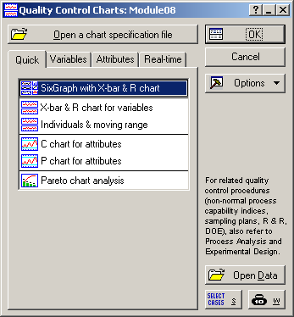
Notes:
Statistics > Industrial Statistics & Six Sigma > Quality Control Charts > SixGraph with X-bar & R chart

Slide 18
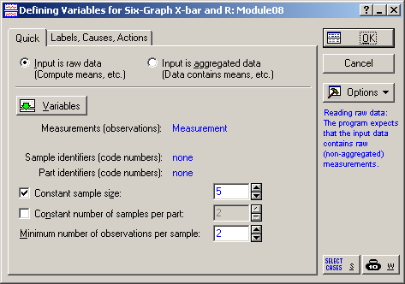
Notes:
Measurements (observations) = Measurement
Constant sample size = 5

Slide 19
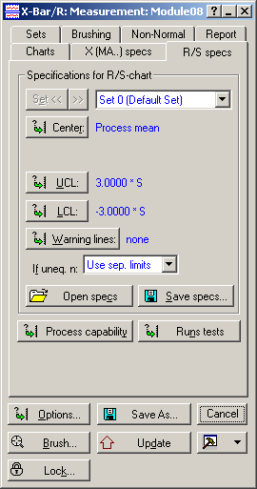
Notes:
Ignore the default graph and go to the “R/S specs” tab and select the “Process capability” button.

Slide 20
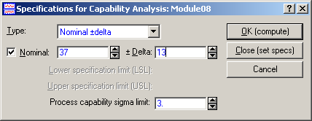
Notes:
Since this part has a two-sided, symmetrical specification, select “Nominal + delta”.
Nominal = 37
Delta = 13
Click OK and then go to the Charts tab and select the “SixGraph” button.

Slide 21
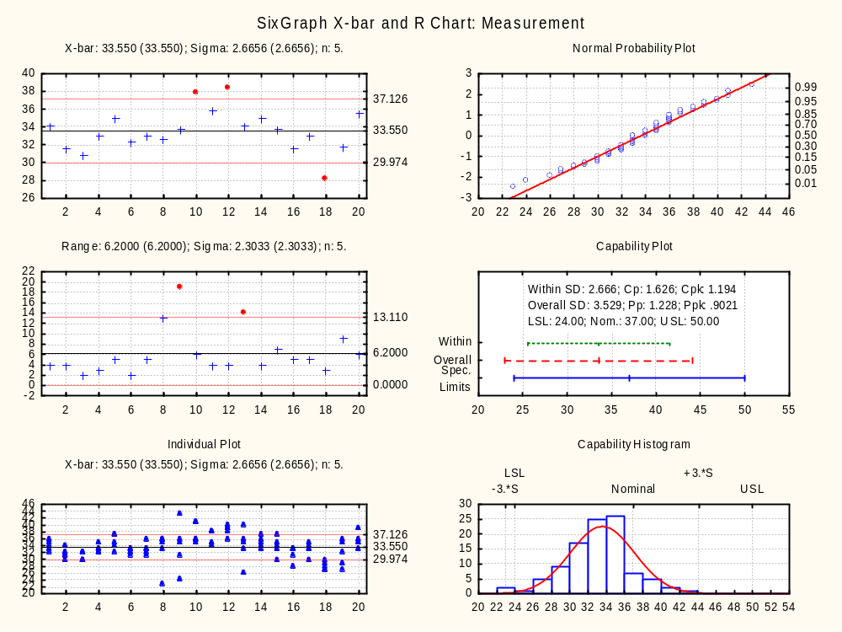
Notes:
This process is not in control, so the previous results are “dubious at best.”
The process should be improved by eliminating special cause variation.

Slide 22
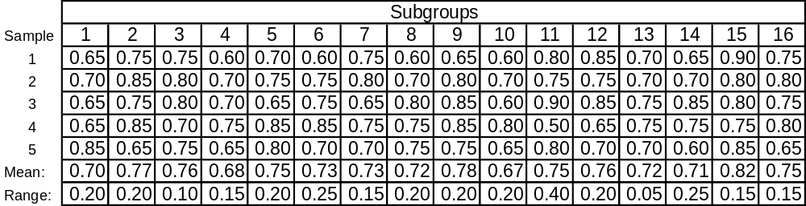
Table 11.2 Data for Assessment of Process Capability/Performance Indices
Notes:
11.12 Example 11.2: Process Capability/Performance Indices Study
Page 275: The data in Table 11.2 are from the AIAG Statistical Process Control (SPC) Reference Manual (1995).
LSL = 0.500
USL = 0.900
This implies the spec is 0.7 + 0.2.

Slide 23
Notes:
Statistics > Industrial Statistics & Six Sigma > Process Analysis > Process capability analysis & tolerance intervals, raw data

Slide 24
Notes:
Grouping tab
Variables = Measurement
Constant sample size = 5
Select “Process specs” button

Slide 25
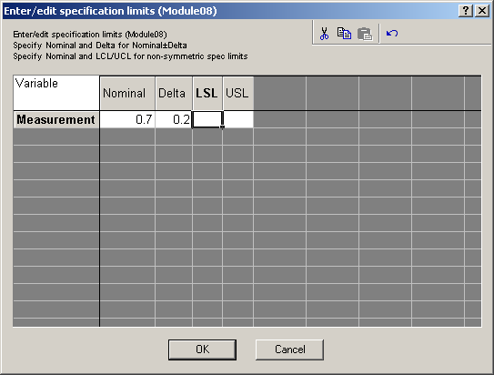
Notes:
Nominal = 0.7
Delta = 0.2

Slide 26
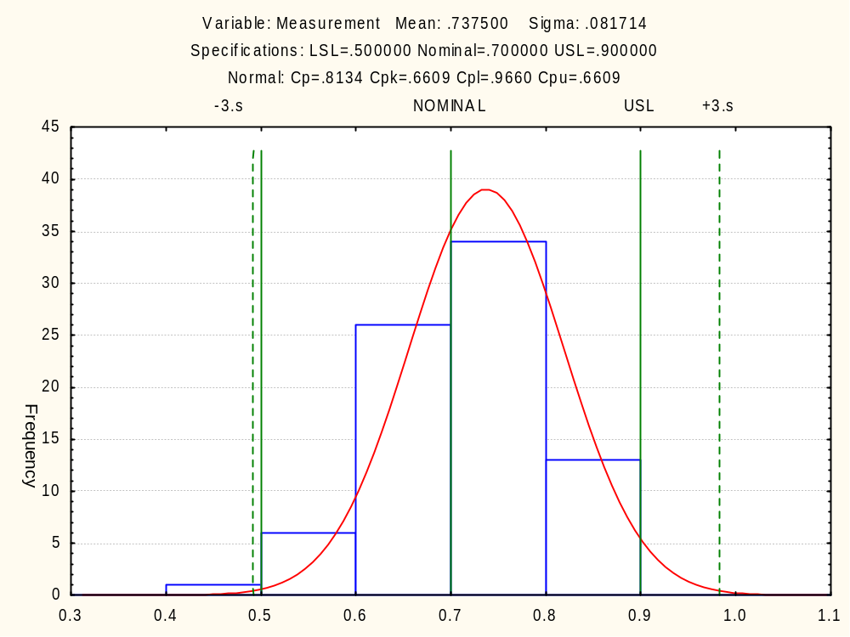
Notes:
Mean = 0.7375
Sigma = 0.081714 (based on sample standard deviation formula)
Cp = 0.8134
Cpk = 0.6609 (Cpl = 0.9660, Cpu = 0.6609)
Return to the Quick tab and select the “Summary: Current variable” button.

Slide 27
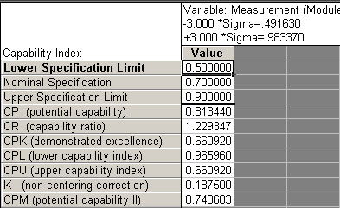
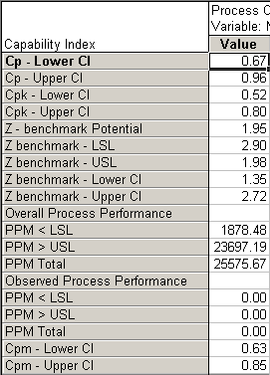
Notes:
Compare results to those listed on pages 277 and 278.
Cp = 0.8134
Cpk = 0.6610
Z LSL = 2.90
Z USL = 1.98
PPM LSL = 1,878
PPM USL = 23,697
PPM Total = 25,576

Slide 28
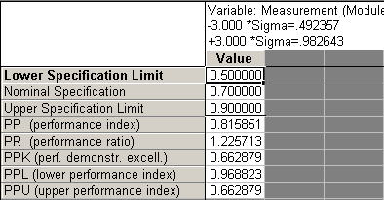
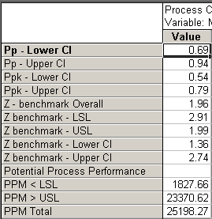
Notes:
Compare results to those listed on page 278.
Pp = 0.8159
Ppk = 0.6629 (Ppl = 0.9688, Ppu = 0.6629)

Slide 29
Notes:
Statistics > Industrial Statistics & Six Sigma > Quality Control Charts > SixGraph with X-bar & R chart

Slide 30
Notes:
Measurements (observations) = Measurement
Constant sample size = 5

Slide 31
Notes:
Ignore the default graph and go to the “R/S specs” tab and select the “Process capability” button.

Slide 32

Notes:
Since this part has a two-sided, symmetrical specification, select “Nominal + delta”.
Nominal = 0.7
Delta = 0.2
Click OK and then go to the Charts tab and select the “SixGraph” button.

Slide 33
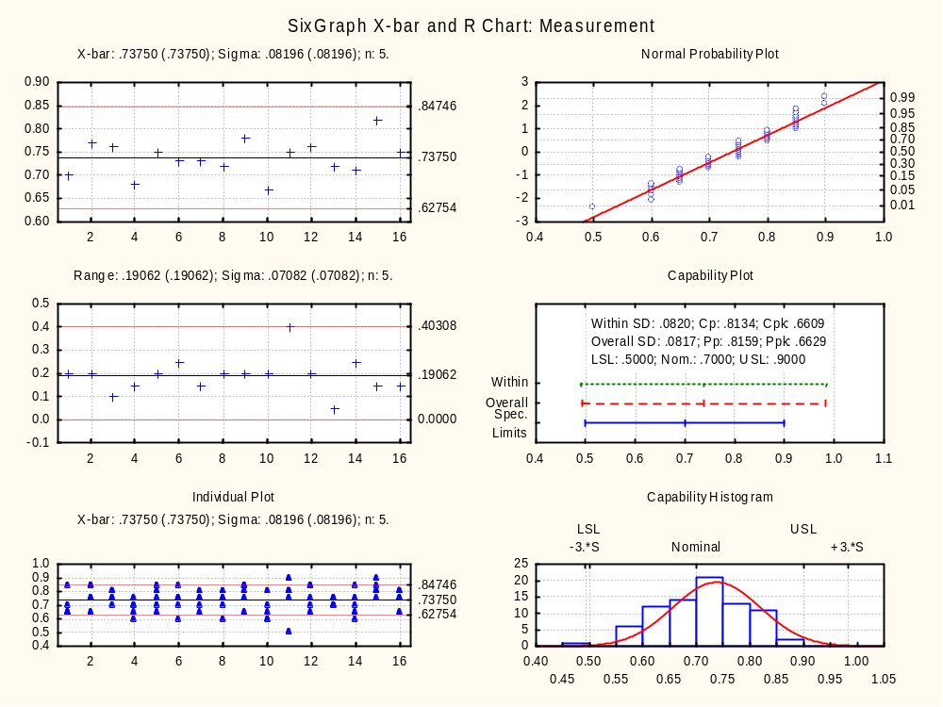
Notes:
Compare to FIGURE 11.4 Example X-bar and R chart.
Page 275: “The X-bar and R charts of the data shown in Figure 11.4 indicates that the process is in control.”
Therefore the process capability and performance indices are relevant, but their values are inadequate, so the process should be improved by reducing the common cause variation.

